Slide 1
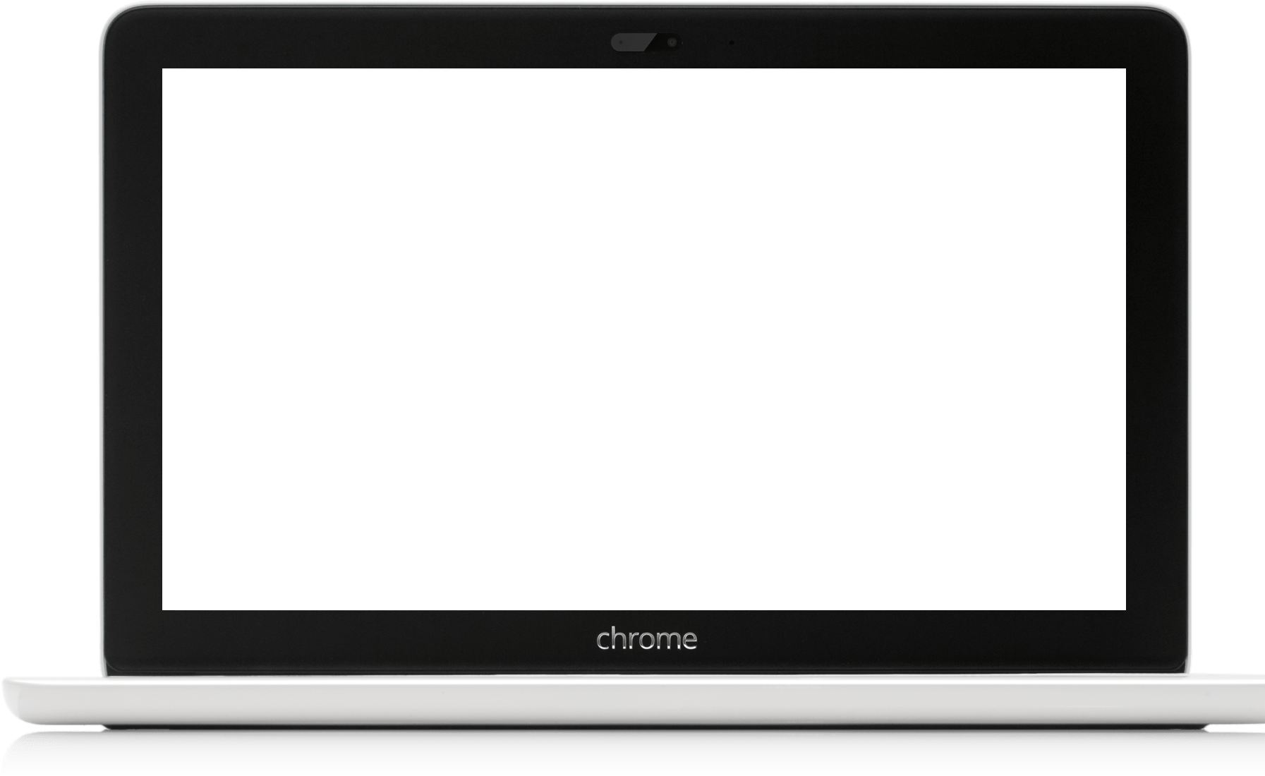
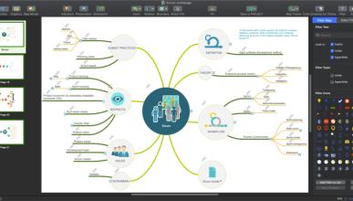
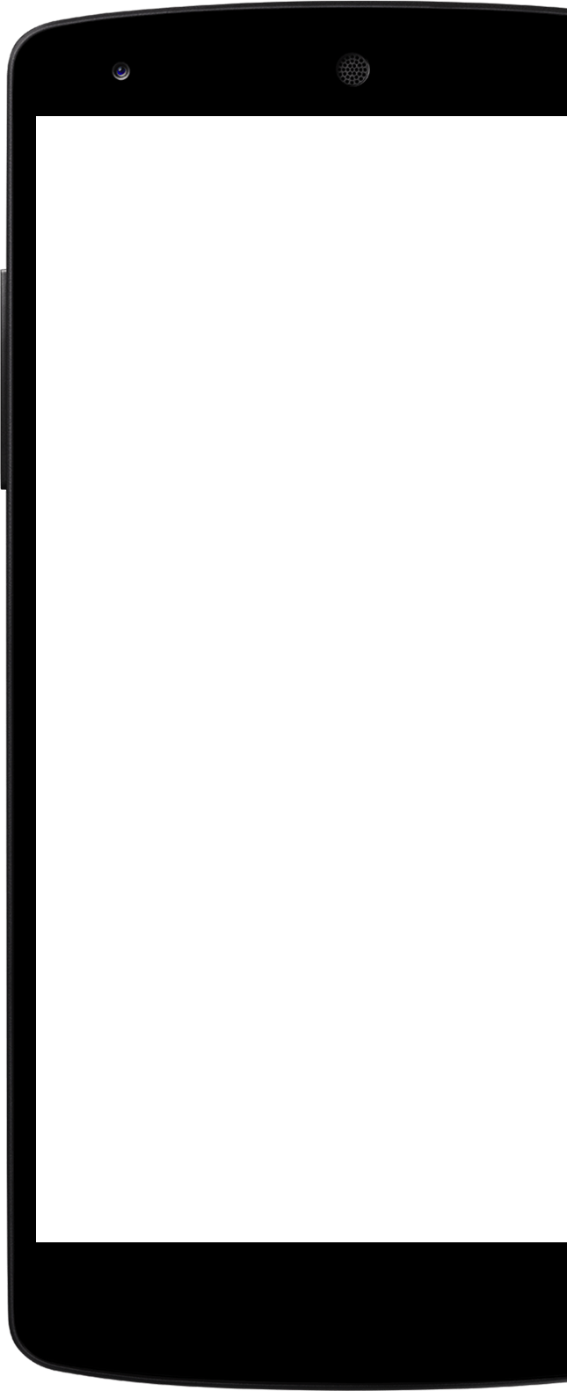

Project Exhibition
Review 3

Slide 2
Index
Project Title
Team Members
About Our Website
Existing Work
Limitations
Proposed Work And Methodology
Novelty of the Project
Real TIme Usage
Hardware/Software Requirements
Overall Architecture And flowchart Diagram
Literature Review
Module Description
Module workflow explanation
Implementation and coding
Demo Video
Project snapshots
Testing
Conclusion

Slide 3
Project Title - VIBEZZ
UNDER THE SUPERVISION OF:
Dr.Nitin Kumar Mishra

Slide 4
Team Members

Slide 5

Team Member
01
Created the Main page of the website using HTML, CSS, JAVASCRIPT.
Created the Playlist page using HTML & CSS.
Created the Search page using Spotify Web API where Users can listen to millions of the songs.
Rahul Pandey (21BCE10117)
Team Manager
Full Stack Website Development

Slide 6
Team Member
02
Created the landing page using HTML, CSS AND JAVASCRIPT.
Created the login page using PHP and mySQL.
Developed the database for storing user credentials.
Rahul Singh (21BCE10113)
1 )Team Manager)
Full stack Web Development

Slide 7
Team Member
03
Designed the Whole Website user interface i.e landing page, login page, sign in page, Main page, Playlist page etc using FIGMA.
Hritvij Pal (21BCE10662)
Team Member
UI/UX DESIGNER

Slide 8
Team Member
04
Designed the Website user interface using FIGMA.
Abhigyan Srivastava (21BCE10664)
Team Member
UI/UX Design

Slide 9
About Our Website
We built a music streaming web Application which is responsive and can be used both mobile and desktop. User can stream new songs and listen to them whenever and wherever they want. The user can add songs to their playlist and the streaming songs can be downloaded to their local machine, also we have the search option so that user can browse his own song, album, artist or composer the individual wants to listen to. We have used Spotify API to fetch the songs to our Application. We have a dark theme so that the user won’t get their eyes strained even after using the application for a long time.

Slide 10
Why Did we choose to work on this Project?
The reason we choose to work upon this project is because music has become part of our day to day life. Music helps to refresh our mind, this is one of the reasons which motivated us to built this application.
If we see in the developer point of view by building this application it had helped us to cover all the technologies we have learned so far and mainly it consists all CRUD operations to work on, so we choose to work upon this project.

Slide 11
Existing Work
It’s hard to pinpoint just one music streaming service that can be called the “best,” as what that means differs from person to person. It’s possible to find something great in many of the largest and most competitive options, as they all have wonderful features worth considering. Using analysis published by TechRadar, here is a look at a handful of music streaming services and reasoning as to why they are worth signing up for:
Spotify – Best Overall – It’s easy to use, and at least in America, it’s the most popular, so why not go with the option everyone seems to love?
Tidal – Best Audio Quality – When Tidal launched several years ago with many of the biggest musicians on board as co-owners, the main differentiator was the quality of the audio, which remains unbeatable.
Apple Music – Best Design – From its beginning, Apple has been known as a leader when it comes to design. Everything the company releases is beautiful, and that remains true with its music streaming platform.

Slide 12
Limitations
One of the limitations of our website is that one cannot create his own playlist.
Users cannot get the music recommendations from what they are listening
The backEnd part of our Project still in development phase.
So most of the feature that other music streaming website provides are not in our website.
THrough The web-API one can only listen to the preview of the song.

Slide 13
Proposed Work and Methodology
The application is a simple HTML file that you open in your browser.
You only need to download a zip file from the button near the beginning of the article, and unzip it somewhere on your computer.
Unfortunately, due to security restrictions in modern browsers it won't work if you just double click the index.html file.
You will have to open it through a locally running web server like Apache or Nginx and access it through local host. Or you can just use our demo, nothing is uploaded so your music is safe.
The app listens for JavaScript drag and drop events. • When you drop a mp3 file, it extracts information like song and artist name, if they are available, from the file's ID3 tags.
Each song is placed in an array, which represents our playlist.
The application then initialises the Wavesurfer.js audio player, which generates the awesome wave visualisation for every song and plays it.
From there on we can do everything you would expect from a native audio player - play next/previous, pause, pick songs and so on.
Our playlist section also gives users the option to remove songs from the player or search for a particular track, album or artist.

Slide 14
Novelty of the Project
LOGIN PAGE: Users need to be get sign up into our website for music streaming.
Search: Users Can search from the millions of songs that they wish to listen with track info.
USERS can Access their playlist from spotify through spotify web API.

Slide 15
Real time Usage
Streaming makes music more accessible to everyone anywhere on the planet.
Many times the sound quality of streamed music will be far superior to that of songs on CDs.
Subscribers will have access to out-of-print recordings.
Streaming doesn’t take up space on the user’s hard drive.
Streaming services offer customers a vast selection of music to choose from.
Subscribers can easily create their own playlists.
New artists and genres of music are more accessible to customers.
Streaming services make customers aware of new releases from their favorite artists.
Up and coming artists stand a much better chance of being discovered.
Subscribers can use their playlist to help make new releases potential hits.

Slide 16
Hardware Requirements
A PC/ handset having a web browser with a good internet connection

Slide 17
Software Requirements
No Softwares are required to use our website.

Slide 18
Overall Architecture And Flowchart Diagram

Slide 19
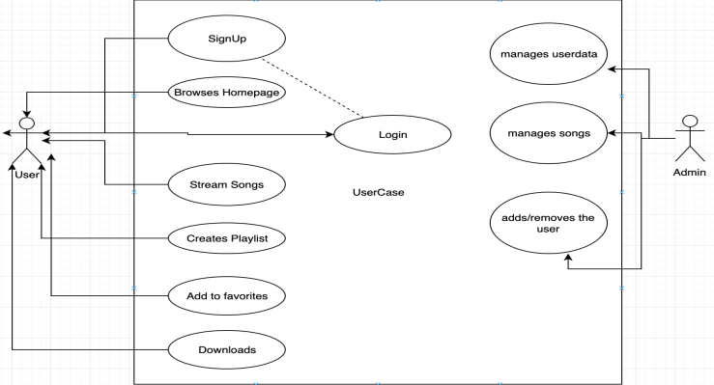
USER CASE DIAGRAM

Slide 20
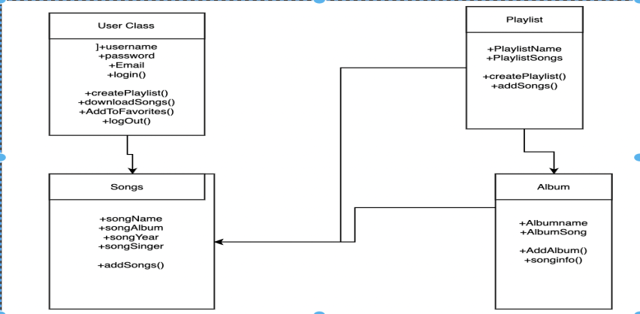
CLASS DIAGRAM

Slide 21
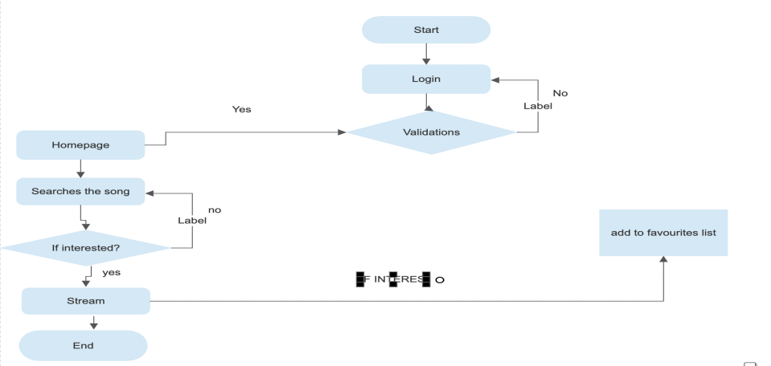
Flowchart

Slide 22
Literature Review
Research on music streaming has so far tended to normalize a view of streaming as
an individual activity solely oriented towards the platform. However, as streaming
media have become integral to everyday life and a key metaphor for digital society,
we should pay attention to how streaming activities are embedded into social power
relations. Furthermore, due to the complexity of streaming infrastructures, we should
consider the social implications of ordinary expertise pertaining to the handling of
digital streams. To this end, this article advances a theoretical view of music streaming
as a form of logistical labour and a part of dwelling. Based on a focus-group study on
music streaming, the analysis moves beyond the platform to explore social dominance
in a cultural landscape where logistical expertise is increasingly important. The analysis
shows how the handling of everyday infrastructures underpins complicit forms of
logistical dominance and translates into symbolic violence.

Slide 23
Module Description
The technologies we have used to build this web application are:
FIGMA : We used FIGMA to design the whole website interface which should be more user friendly.
HTML CSS & JAVASCRIPT : we used HTML CSS & JAVASCRIPT for making the responsive website.
Spotify-Web API: we used spotify web API to fetch our dynamic data i.e song tracks,albums,song info.
PHP & mySQL: we used PHP and mySQL for storing and managing user data from SignUP and signIN page
HyperPHP : to deploy our website publicly.

Slide 24
Module Workflow Explanation
LANDING PAGE
SIGN IN PAGE
After logging in/signing in user has accessed to our main website
On the main website, user can listen multiple songs that our available on our main page.
If a user wants to search some songs, user can go to our search page, where he/she can find any song worldwide.

Slide 25
Implementation and Coding
In the Very first we have created a landing page for our website.
In the landing page we have added the about us page and contact us page
Then we have created the main page of our website on which we can listen music
Then we have created the playlist page.
Then we created the login/sign in page for our website through PHP & mySQL.
Then we added the login page to our landing page
After that, by using the spotify API, we created a search page through which one can stream to millions of songs.

Slide 26
CODING SNAPS FROM THE WEBSITE DEVELOPMENT

Slide 27
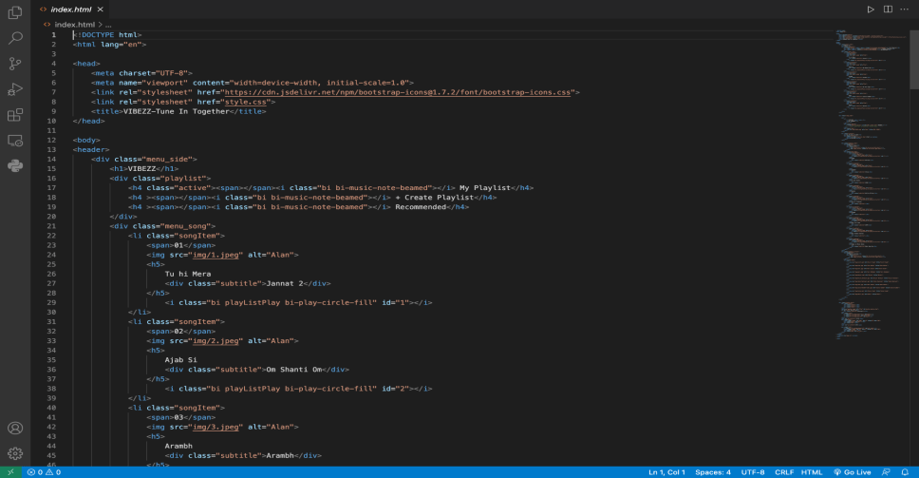
MAIN PAGE HTML CODE

Slide 28
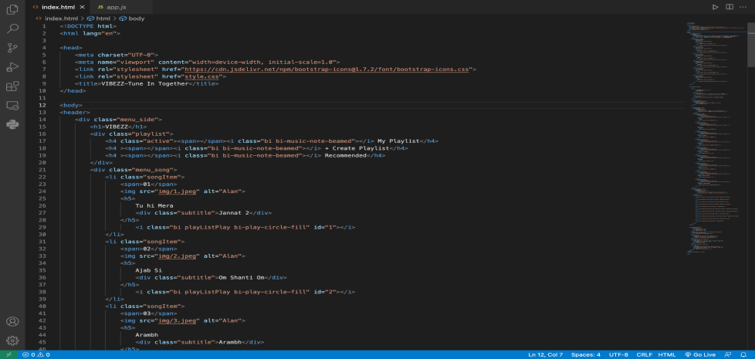
MAIN PAGE HTML STYLESHEET

Slide 29
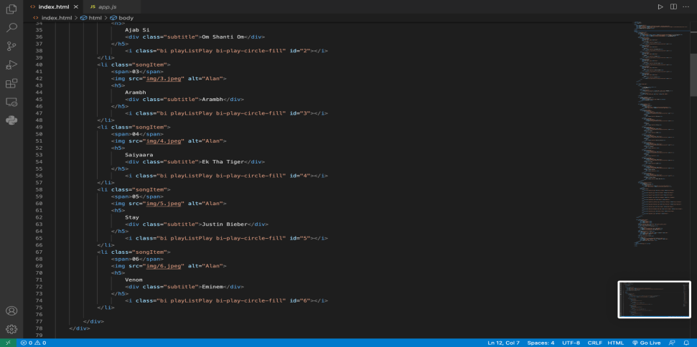
MAIN PAGE JAVASCRIPT

Slide 30
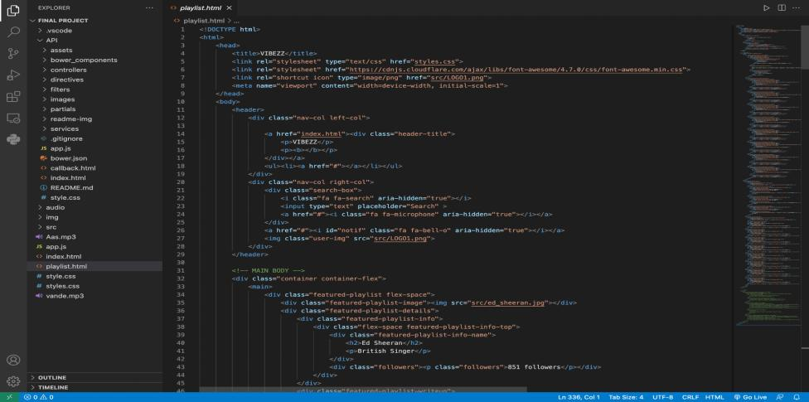
PLAYLIST PAGE HTML

Slide 31
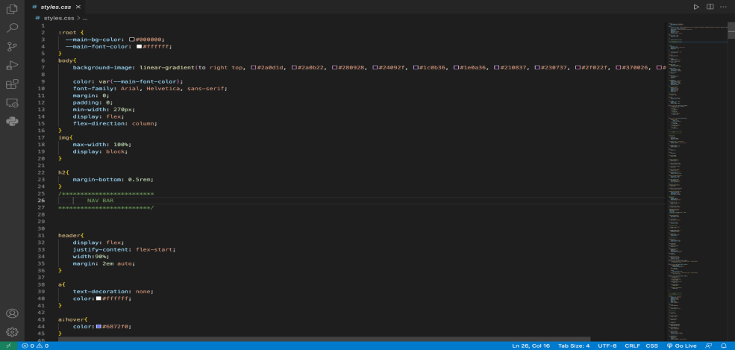
PLAYLIST PAGE STYLESHEET

Slide 32
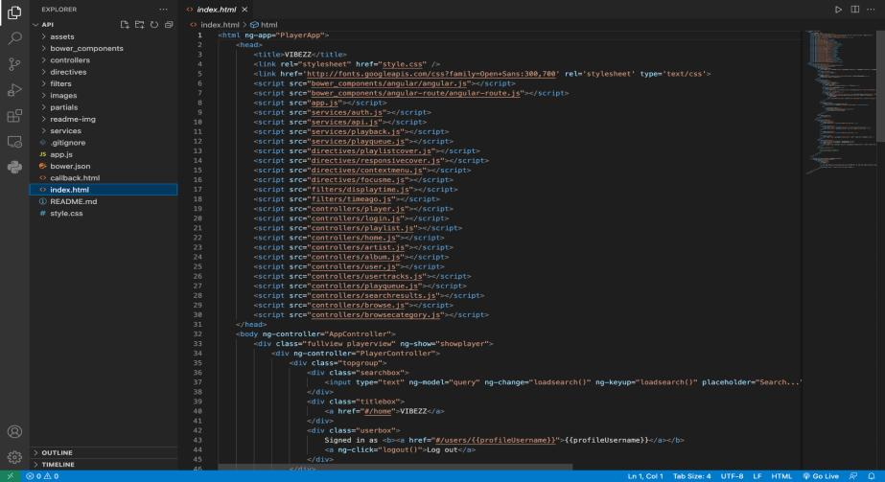
SEARCH PAGE HTML

Slide 33
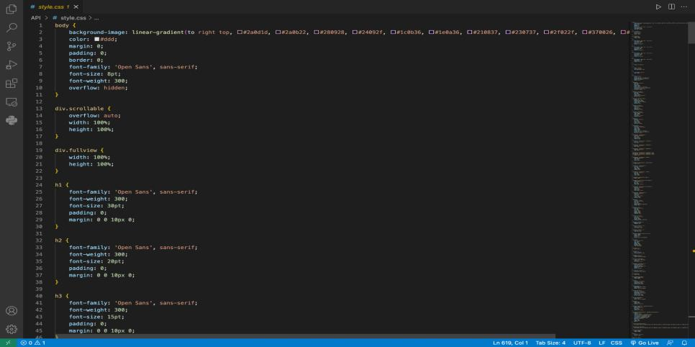
SEARCH PAGE STYLESHEET

Slide 34
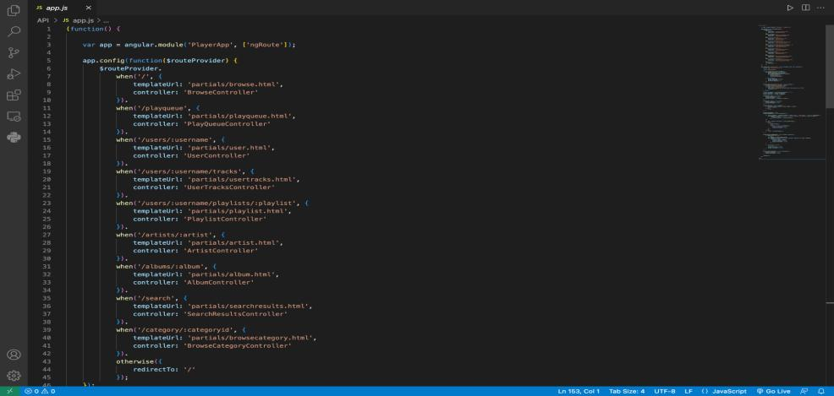
SEARCH PAGE JAVASCRIPT

Slide 35

Demo video
Project Demo -

Slide 36
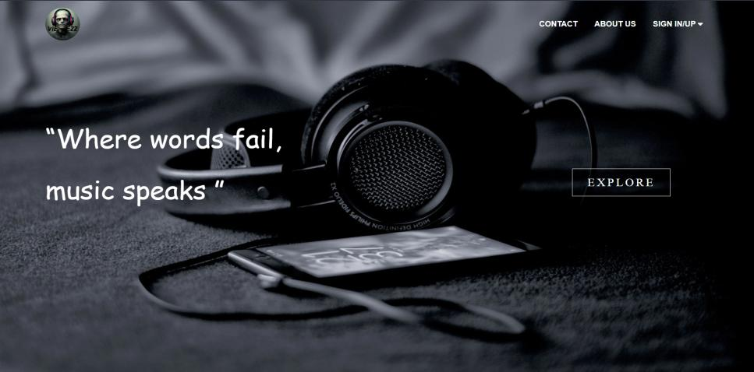
Website’s Landing Page

Slide 37
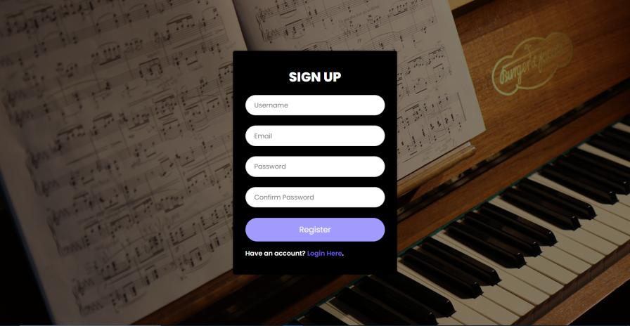
Website’s Login Page

Slide 38
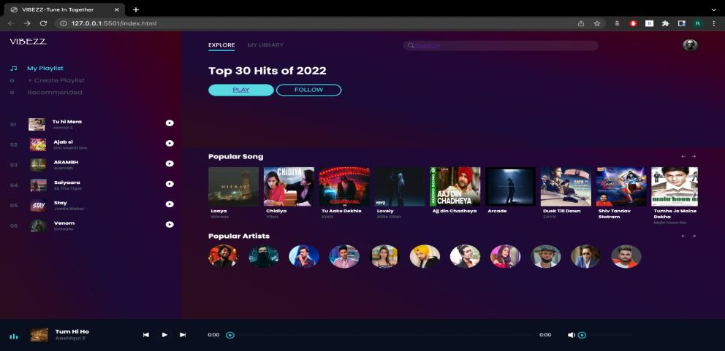
WEBSITE’S MAIN PAGE

Slide 39
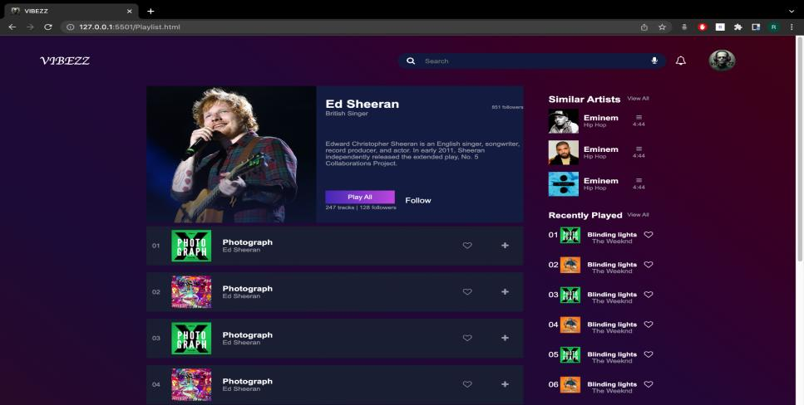
PLAYLIST PAGE

Slide 40
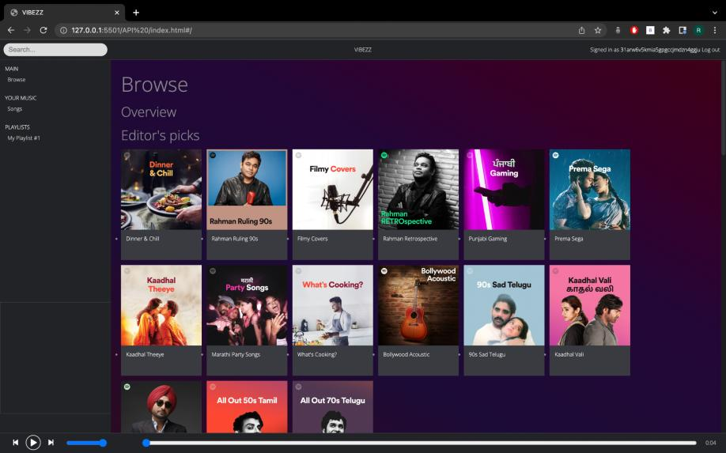
WEBSITE SEARCH PAGE

Slide 41
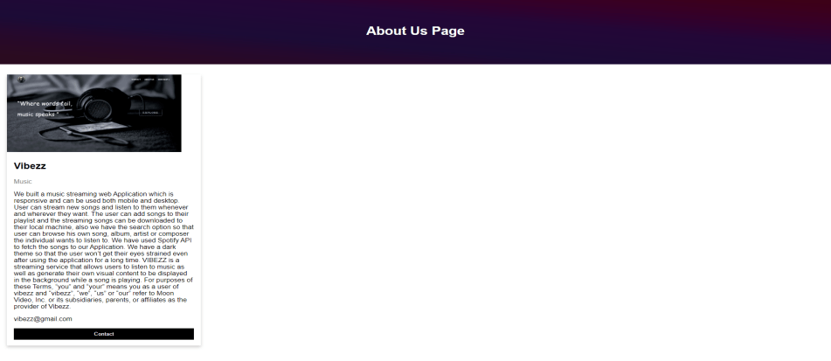
About Us

Slide 42
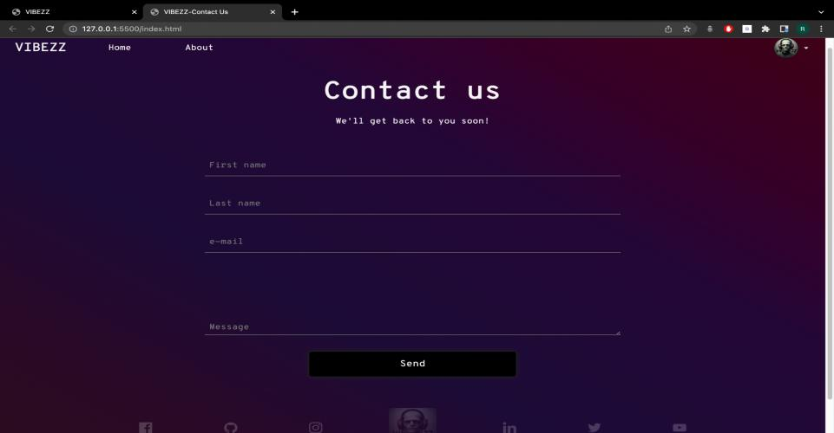
CONTACT US PAGE

Slide 43
TESTING
registration / authorization
system components and their interaction
interaction with social networks including sharing, feeds, followers
system performance during multiple artists playback
system stability while using different types of internet connection and offline mode
playback of content in different formats
the application responds to interrupts

Slide 44
CONCLUSION
Through the development of music player on WEB platform, we get a clear understanding of overall process of the system. The core part of the music player is mainly composed of main interface, playlists, menus, play Settings, file browsing and song search. Grasping the development of the six parts, the music player has had the preliminary scale. Based on the function of the six categories, add some other small features.
Music player system realized the basic function of player: play, pause, and stop, up/down a, volume adjustment, lyrics display, play mode, song search, file browser, playlists query, and other functions. This development implicated the popular mobile terminal development technology.

Slide 45
THANK YOU

